Slide 1

KHATRA ADIBASI MAHAVIDYALAYA
E-CONTENT
DEPARTMENT OF EDUCATION
SEMESTER-VI (PROGRAMME)
SESSION: 2022-2023
SUBJECT: EDUCATION
COURSE TITLE: GUIDANCE AND COUNSELLING
COURSE CODE: AP/EDN/601/DSE-1B
TOPIC: COUNSELLING
NAME OF THE TEACHER: RABIN BANERJEE

Slide 2
Counselling
Definition of counselling.
According to Carl Rogers “Couselling is a series of direct contract with the individual which aims to offer him assistance in changing his attitude and behavior”.
According to Erickson “ Counselling is a person to person relationship in which one individual with problem tours another person for assistance.

Slide 3
Characteristic of Couselling
Continuity,
Establishment of good relationship,
Direct contact,
Presence of experienced person.

Slide 4
Areas of Counselling
Educational couselling,
Career counselling,
Marriage counselling,
Family counselling,
Clinical counselling,
Sports couselling,
Personal counselling,
Gerantological couselling.

Slide 5
Techniques of Counselling
Directive Counselling
Non-directive Counselling
Eclectic Counselling

Slide 6
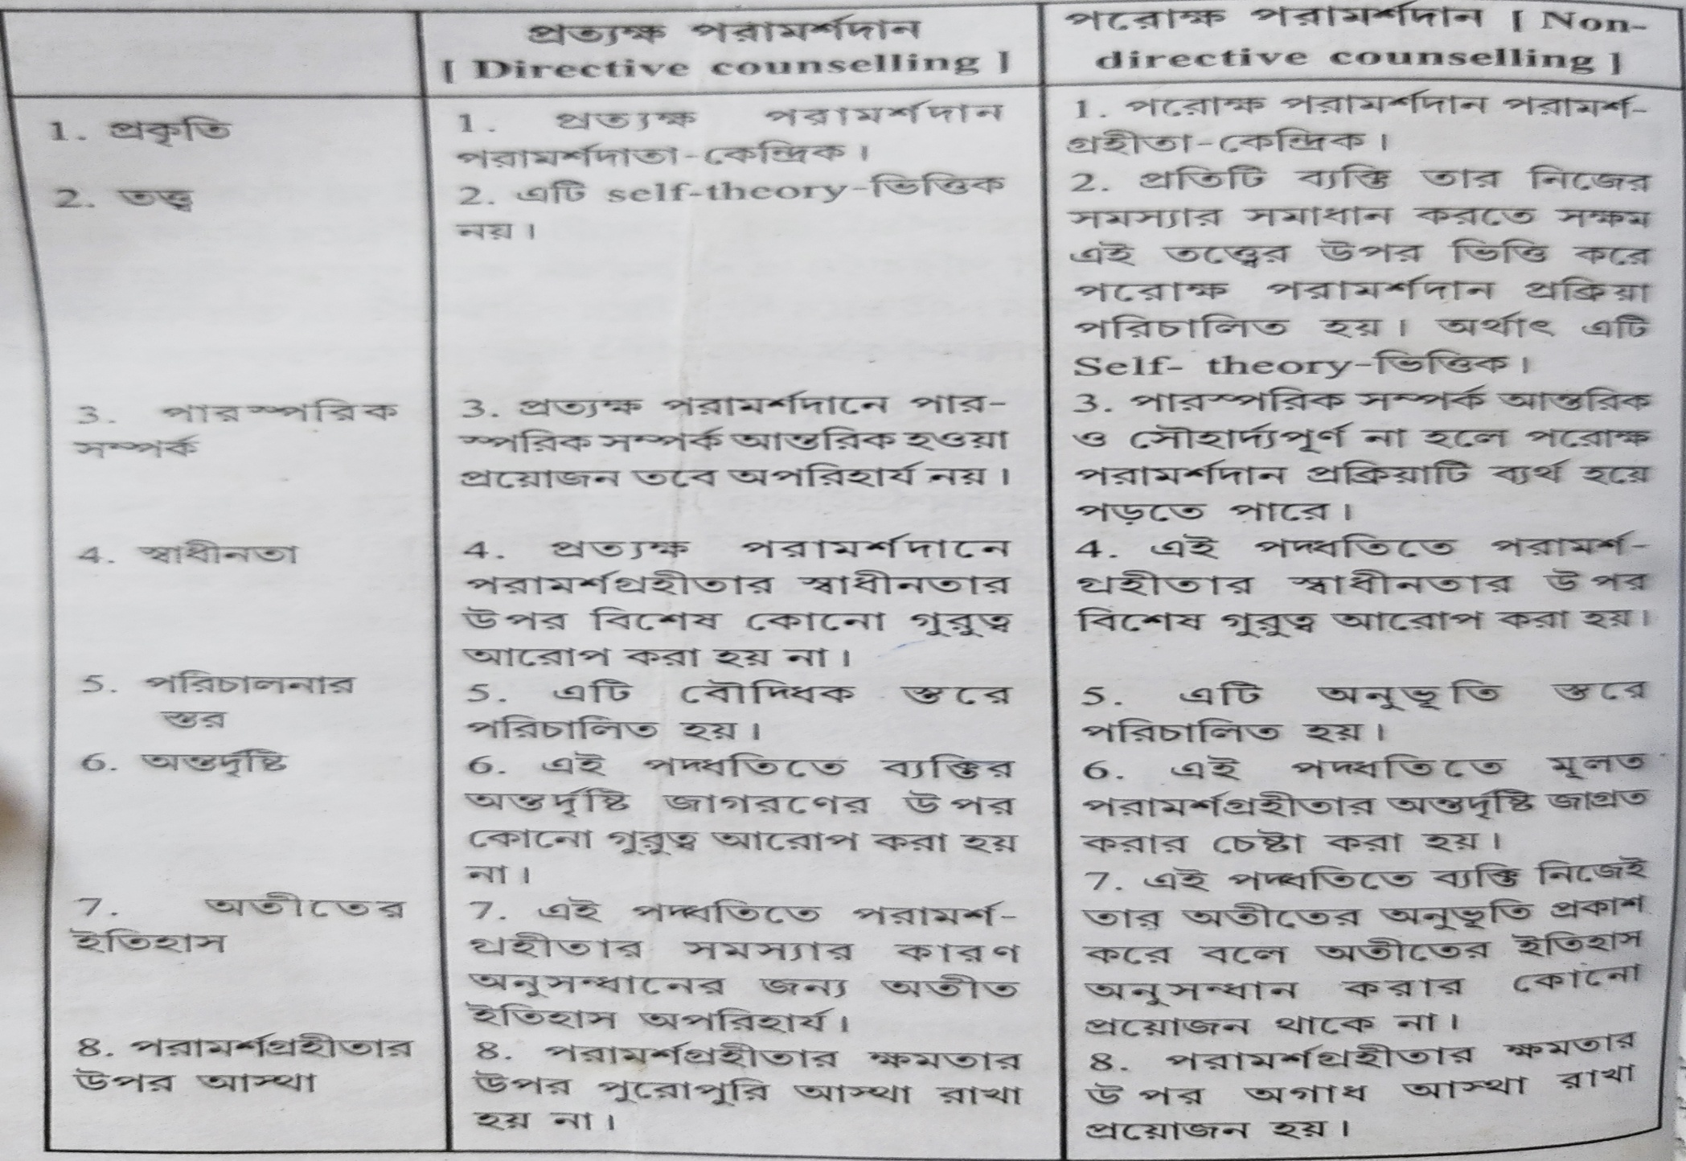
Difference between Directive and Non-directive counselling

